Slide 1


Car Price Prediction:
Welcome to our innovative car price prediction project. We're leveraging cutting-edge machine learning models to accurately estimate vehicle values. Our system helps buyers and sellers make informed decisions in the dynamic automotive market.

Slide 2

Our Team
Shahd Mohamed
Hussien Sanad
Yossief Bahnasy
Mohamed Akram
Ahmed Saeed

Slide 3

Project Overview
Possible ships
1
Problem Statement
Accurate car price estimation is crucial in today's market. Our project addresses this need using advanced machine learning techniques.
2
Project Goal
We aim to develop multiple models for precise car price predictions. This helps both buyers and sellers make informed decisions.
3
Real-World Impact
Our system will revolutionize the used car market. It provides transparency and fairness in pricing for all stakeholders.

Slide 4
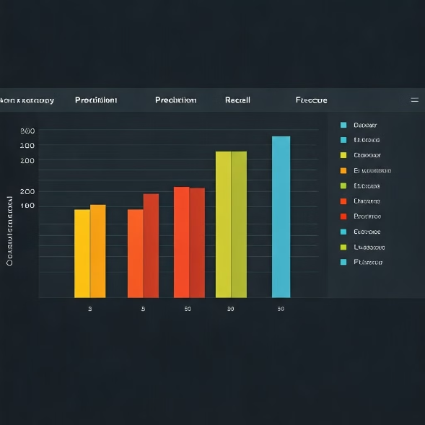
Dataset Features
Vehicle Specifications:Key features such as Make, Model, Year, and Engine Horsepower are used to capture the core performance and brand value, which heavily influence the car's price.
Engine and Transmission: Details like Cylinders, Engine Fuel Type, and Transmission Type affect vehicle performance, fuel efficiency, and driving experience, playing a vital role in pricing.
Fuel Efficiency: City and Highway MPG provide insights into the car's fuel consumption, impacting its long-term cost and, consequently, its market value.
Drive and Size Attributes: Factors like Drive Mode, Vehicle Size, and Vehicle Style are essential in determining the cars capability, comfort, and overall market appeal.

Slide 5
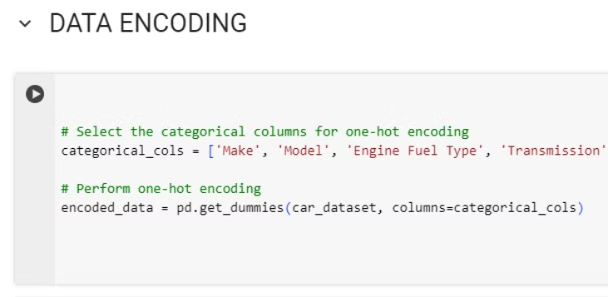
Data Preprocessing
1- Feature Scaling and Encoding
Numerical features like Engine HP and Cylinders were scaled, while categorical variables such as Transmission Type and Vehicle Style were one-hot encoded. This ensured uniform, machine-readable inputs, improving model accuracy and performance.

Slide 6
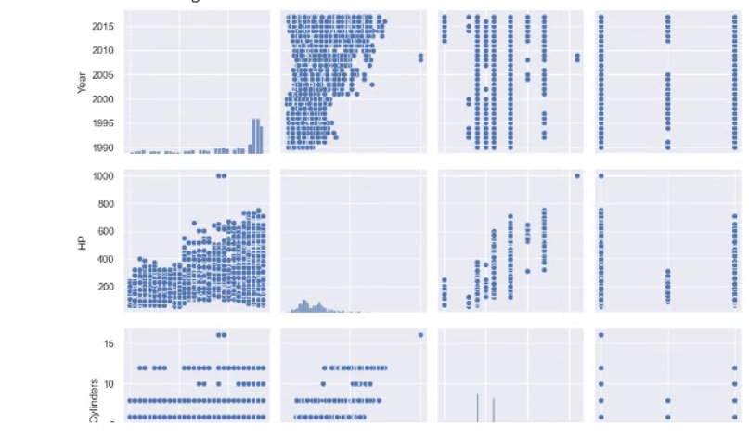
Data Preprocessing
2-Dimensionality Reduction
We implemented Principal Component Analysis (PCA) to reduce the feature set while preserving 95% of the variance. This optimizes model performance and reduces computation time, ensuring the model remains efficient without compromising accuracy.

Slide 7
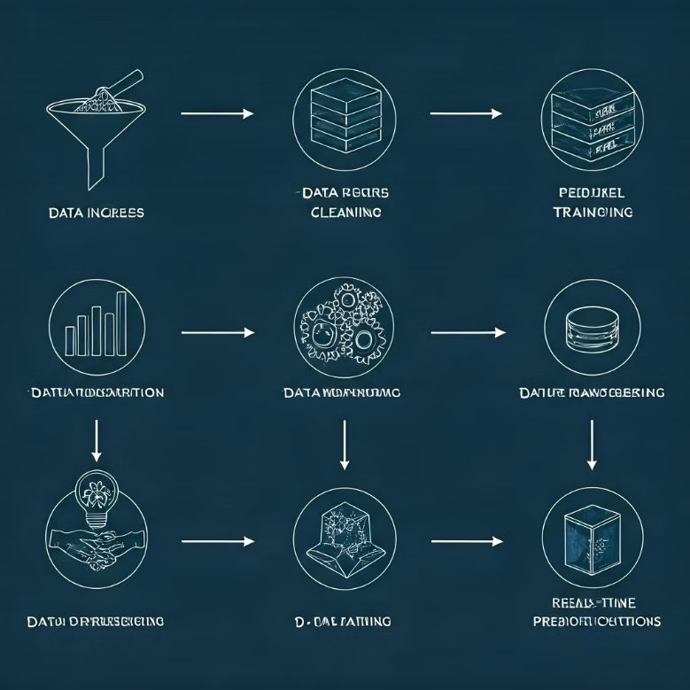
Data Preprocessing
3-Pipeline Creation
A preprocessing pipeline was developed to automate data transformations, enabling seamless integration of new manual inputs for real-time predictions. It was designed for easy deployment, scalability, and efficient processing, ensuring consistent results and streamlined future updates..

Slide 8
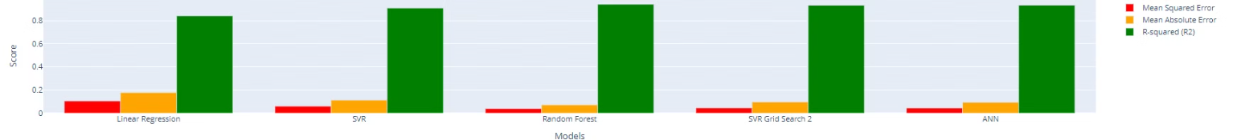
Machine Learning Models

Slide 9
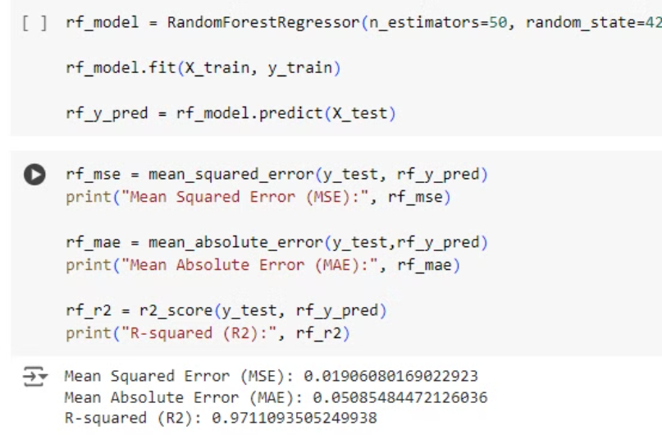
Random Forest Regressor
This ensemble model excels in handling complex relationships, making it highly effective for predicting car prices. In our tests, it achieved:
MSE: 0.0386
MAE: 0.0715
R-squared (R²): 0.9415

Slide 10
Linear Regression
A simple yet effective model, Linear Regression provides a baseline for comparison in predictive modeling. Its performance metrics were:
MSE: 0.1047
MAE: 0.1773
R-squared (R²): 0.8413

Slide 11
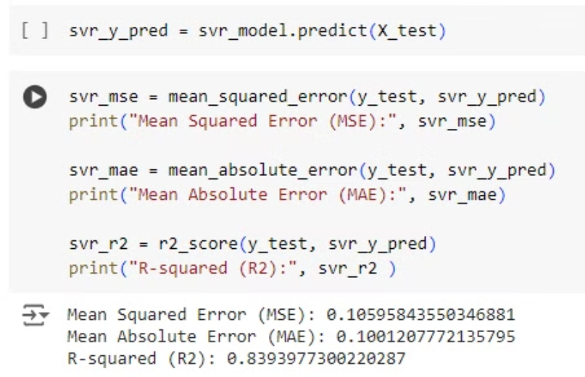
Support Vector Regressor
SVR effectively captures relationships in the data, with and without hyperparameter tuning. The performance metrics were:
MSE: 0.0445
MAE: 0.0960
R-squared (R²): 0.9326

Slide 12
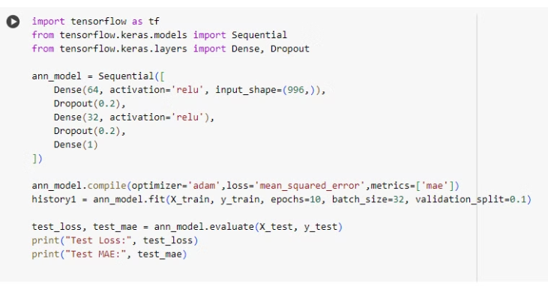
Artificial Neural Network Model
Built with a sequential architecture featuring three hidden layers (819, 64, and 32 neurons) and ReLU activations, it captures complex data relationships. Trained for 50 epochs with a batch size of 16 were:
Test Loss: 0.0437
MAE: 0.0930
R-squared (R²) Score: 0.9337

Slide 13
Model Evaluation
Model
Mean Squared Error (MSE)
R-squared (R²) Score
Random Forest
1,245,678
0.92
Linear Regression
2,345,678
0.85
Decision Tree
1,845,678
0.88

Slide 14



Deployment Strategy
Implementation
The app uses a trained Random Forest model and a preprocessing pipeline to predict car prices based on user inputs. It loads the model and pipeline using Joblib.
Streamlit Web App
We chose Streamlit for its simplicity and interactivity. It allows rapid development of machine learning web applications.
User Input Interface
The app features an intuitive interface. Users can easily input car features to get instant price predictions.

Slide 15

ANN Improvements

Slide 16
Additional Features
Deep Learning Integration
Market Trend Analysis
Incorporating mileage and manufacture year could enhance prediction accuracy. This would provide a more comprehensive analysis of car value.
Exploring neural networks might yield more precise results. This could capture complex, non-linear relationships in car pricing.
Implementing real-time market data integration could improve predictions. This would account for current market fluctuations and trends.

Slide 17

MLFLOW
we used it to monitor the perfomance of machine learning models during training , tracking metrics like accuracy , AUC-ROC curve , confusion matrix for models such as xgboost , LR and Random forest . It helped at visualizing improvement and optimizing hyperparameters effictively

Slide 18
MLflow Integration
Experiment Tracking
Model Versioning
Deployment Management
MLflow helps us log and compare different model iterations. This streamlines our experimentation process and improves model selection.
We use MLflow for efficient model versioning. This ensures reproducibility and easy rollback to previous versions if needed.
MLflow simplifies model deployment and updates. It provides a smooth transition from development to production environments.

Slide 19
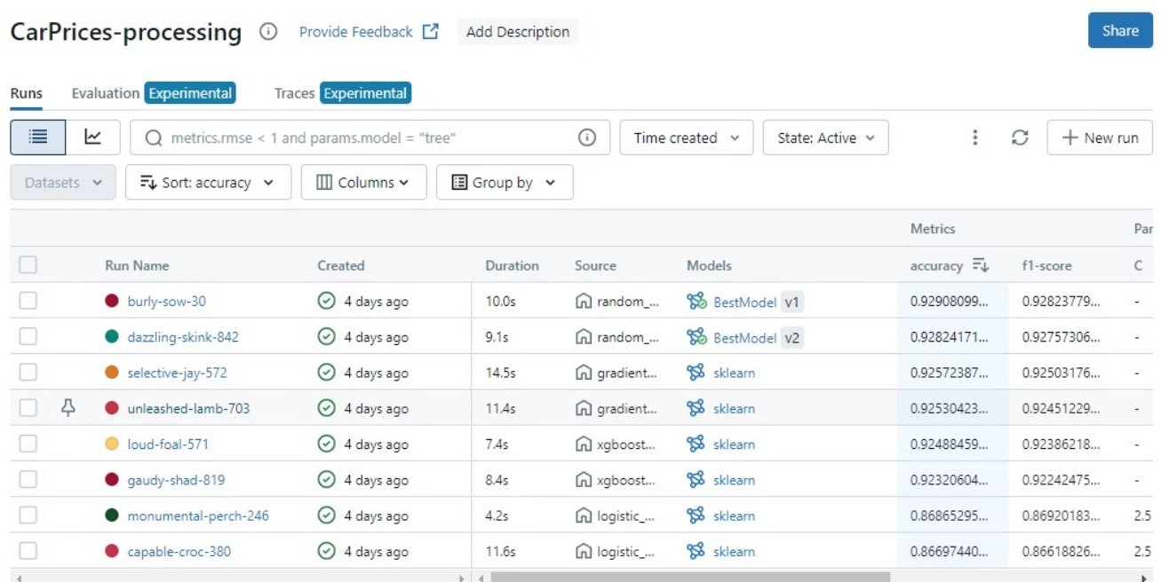
MLFlow Visualizations
MODELS ACCURACIES

Slide 20
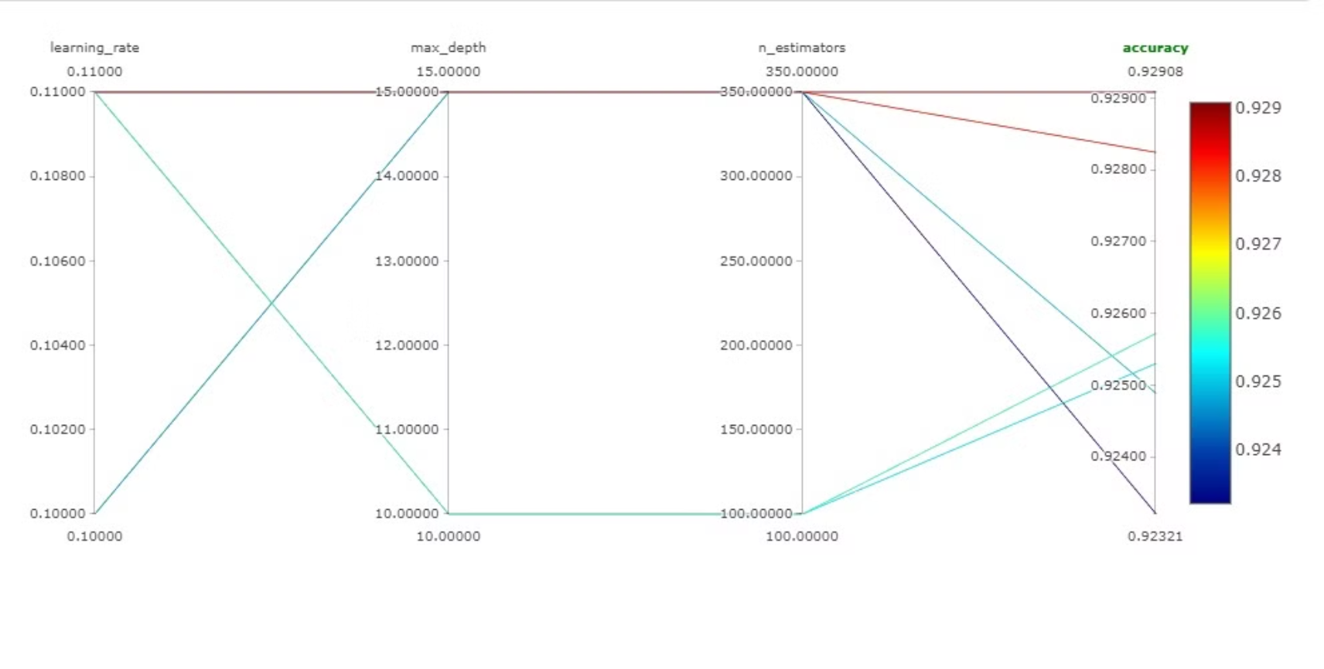
MODELS COMPARISON

Slide 21
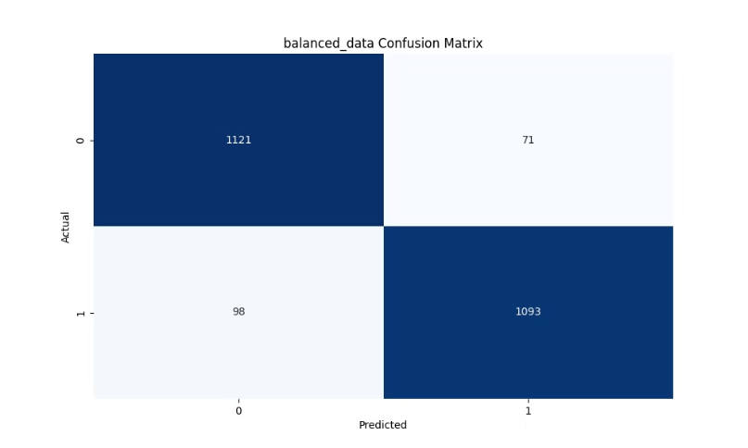
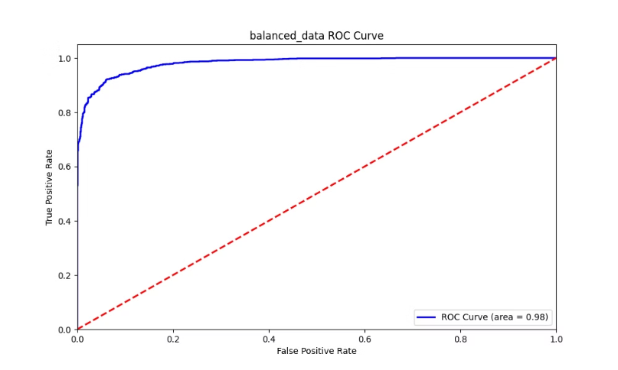
MLFLOW & Random Forest
the best model with 92.9 accuracy

Slide 22
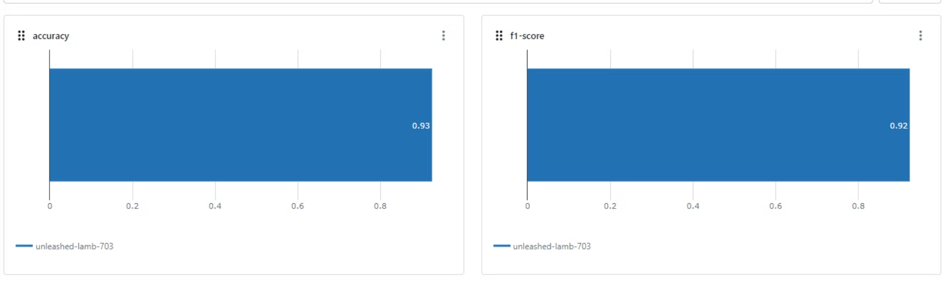
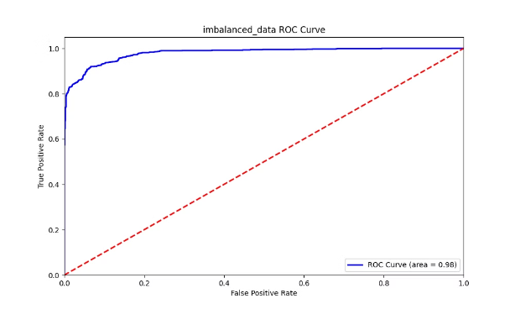
MLFLOW & GradientBoosting

Slide 23
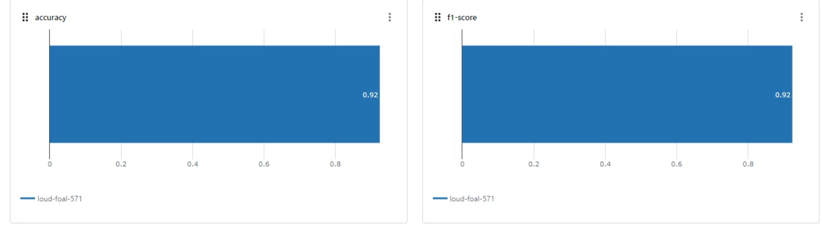
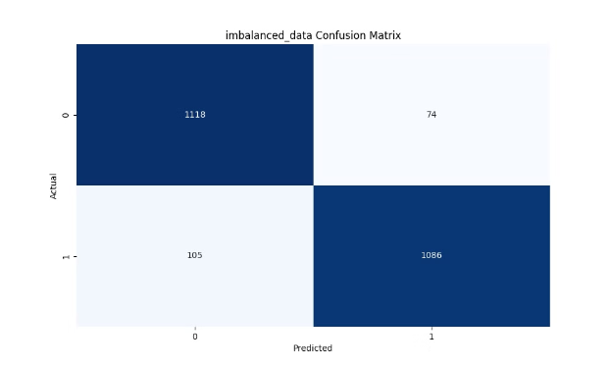
MLFLOW & Xgboost

Slide 24
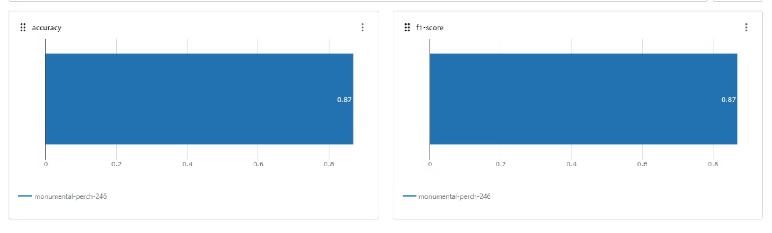
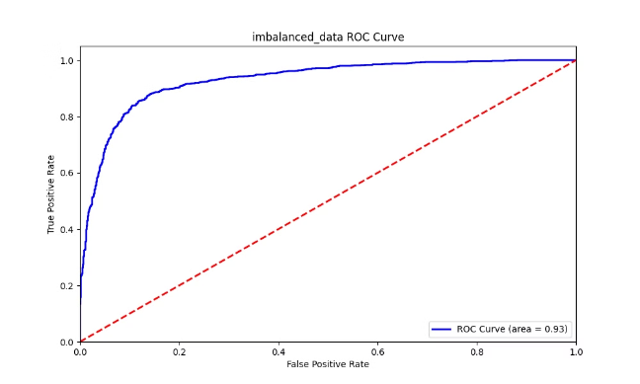
MLFLOW & LogisticRegression

Slide 25

Microsoft AZURE
SIMULATION DESIGN AND WORKFLOW.

Slide 26
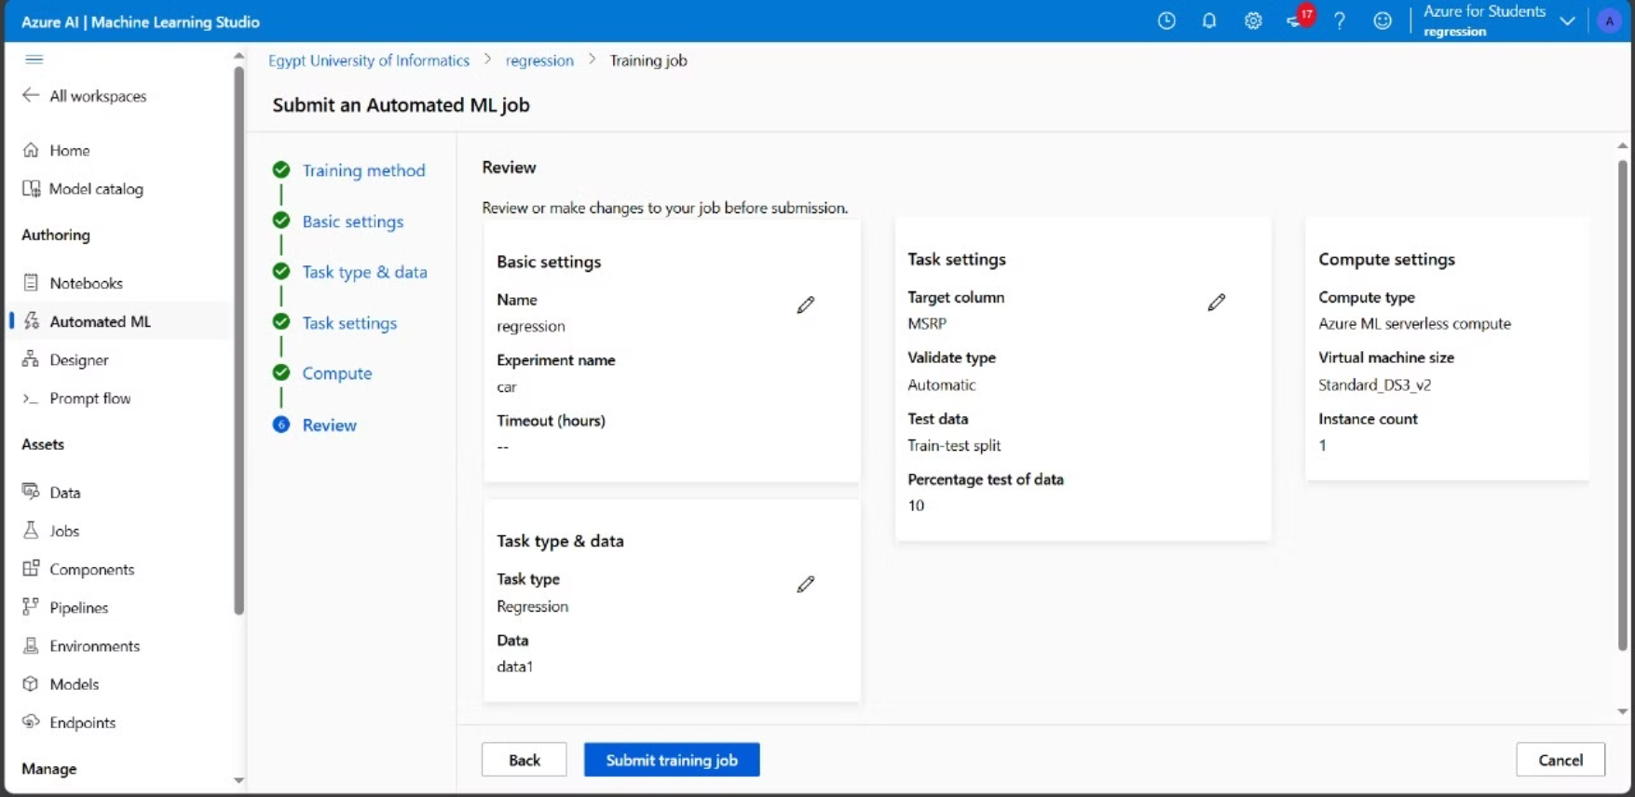
Data Upload and Data Preprocessing:

Slide 27
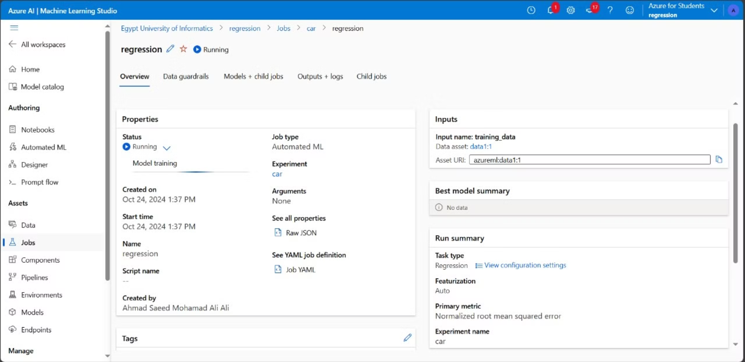
Modeling

Slide 28
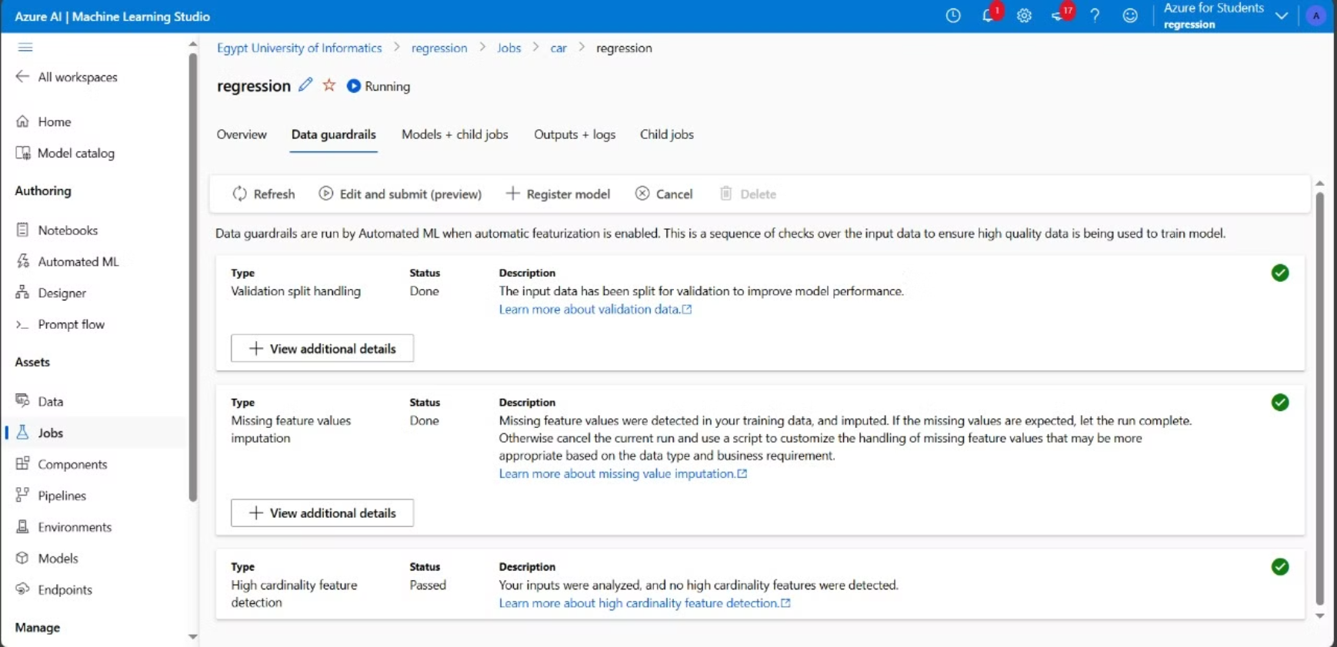
Data guardrails

